Slide 1
Exchange of PHR Content
(XPHR)
IHE Vendors Workshop 2006
IHE Patient Care Coordination Education
Keith W. Boone, GE Healthcare
IHE PCC Co-chair

Slide 2

Exchange of PHR Content
Abstract
The Exchange of Personal Health Record Content (XPHR) provides a standards-based specification for managing the interchange of documents between a Personal Health Record and an EHR System to enable better interoperability between these systems.

Slide 3
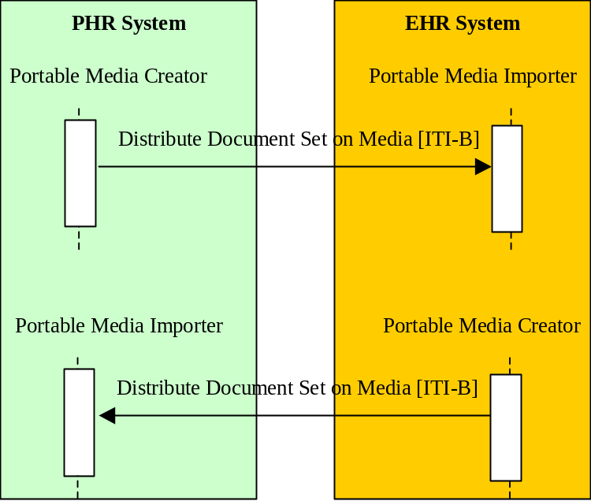
Exchange of PHR Information
Scope
Personal Health Record (PHR) Systems
Electronic Health Record (EHR) Systems

Slide 4
Exchange of PHR Information
Value Proposition
Supports interchange of PHR Information
  Demographics
  Insurance Information
  Medications, Problems, Allergies
  Health History
  Other Information

Slide 5
Exchange of PHR Information
Standards Used
CDA Release 2.0
ASTM Continuity of Care Data Set
ASTM/HL7 Continuity of Care Document
HL7 Care Record Summary
AHIMA PHR Common Data Elements
XDS, XDP
Document Digital Signature

Slide 6
Exchange of PHR Information
Key Technical Properties
Information is Human Readable
and Machine Processable
Support Static and Dynamic Information Sharing Domains (XDS and XDP)
Protects Information using Digital Signature
Update Model for EHR to PHR Changes

